Slide 1
Basics of compiler

Slide 2
Team members
Eteka Sultana Tumpa 191-15-12121
Shimul Shutradhar 191-15-12614
Shabrina Sharmin 191-15-12855
Tanjima Akhanda 191-15-2455

Slide 3
History of Compiler

Slide 4
What is compiler
Source Program
66% of US consumers spend money on multiple products that only partially resolves their issue
Compiler
Millennials account for about a quarter of the $48 billion spent on other products in 2018
Target Program
Loss of productivity costing consumers thousands of dollars

Slide 5
What is interpreter
Source Program
Interpreter
Output
Input

Slide 6
Preprocessing
Preprocessing
Source Code
Object Code
Machine
Preprocessing
Preprocessing
Intermediate
Code
Preprocessing
Source Code
Interpreter
COMPILER AND INTERPRETER

Slide 7
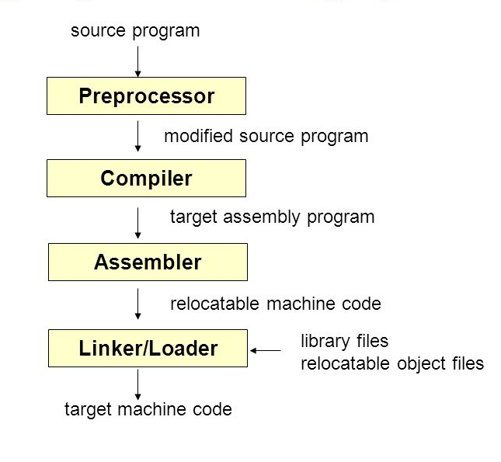
Structure of compiler

Slide 8
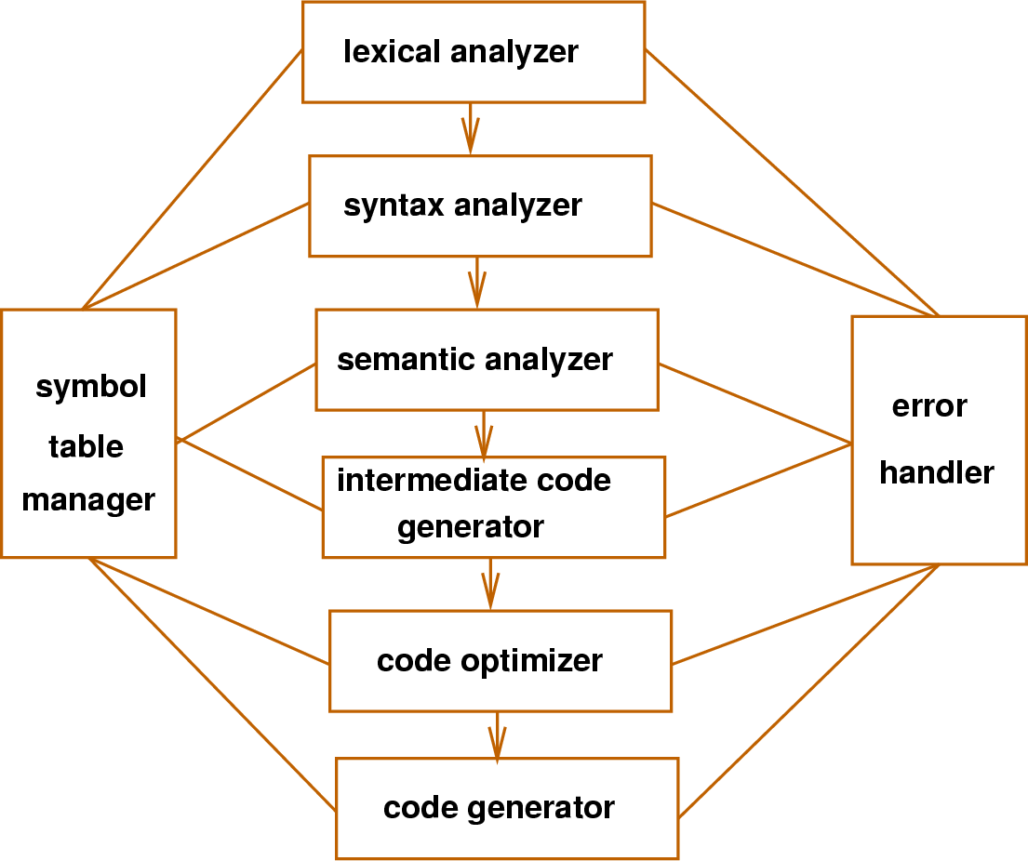
PHASES OF COMPILER

Slide 9
Why use a Compiler?

Slide 10
Types of compiler
Single Pass Compilers
Two Pass Compilers
Multipass Compilers

Slide 11
Tasks of Compiler

Slide 12
Compiler Construction Tools
$3B
$2B
$1B
Freedom to invent
Few competitors
Addressable market
Serviceable market
Obtainable market

Slide 13
Features of Compiler

Slide 14
Advantages and disadvantages of Compiler

Slide 15

THANKS !

